Slide 1
Module 1 Introduction to Web Technology

Slide 2
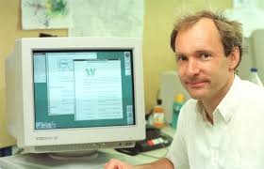
Web History
Berners-Lee, a British scientist, invented the World Wide Web (WWW) in 1989, while working at CERN.
The Web was originally conceived and developed to meet the demand for automated information-sharing between scientists in universities and institutes around the world.
CERN is not an isolated laboratory, but rather the focal point for an extensive community that includes more than 17 000 scientists from over 100 countries. Although they typically spend some time on the CERN site, the scientists usually work at universities and national laboratories in their home countries. Reliable communication tools are therefore essential. CERN is the European Organization for Nuclear Research
The basic idea of the WWW was to merge the evolving technologies of computers, data networks and hypertext into a powerful and easy to use global information system.
Tim Berners-Lee, pictured at CERN

Slide 3
Introduction
Web development refers to the building, creating, and maintaining of websites. It includes aspects such as web design, web publishing, web programming, and database management.
It is the creation of an application that works over the internet i.e. websites.
The term development is usually reserved for the actual construction of these things (that is to say, the programming of sites). The basic tools involved are programming languages called HTML (Hypertext Markup Language), CSS (Cascading Style Sheets), and JavaScript.
3
Notes:
SAY: Before we wrap up the course, let’s review what we have learned today.
During this course, we have
<READ the bullets from the slide.>
GO to next slide.

Slide 4
Client server
The Client-server model is a distributed application structure that partitions task or workload between the providers of a resource or service, called servers, and service requesters called clients.
In the client-server architecture, when the client computer sends a request for data to the server through the internet, the server accepts the requested process and deliver the data packets requested back to the client.
Clients do not share any of their resources.
Examples of Client-Server Model are Email, World Wide Web, etc.

Slide 5
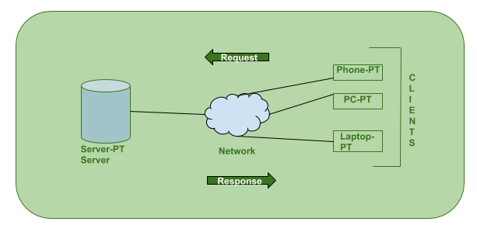
Internet works via, web browsers. Let us a solid foundation of the WEB and it will help in working with WEB technologies with ease.
Client: When we talk the word Client, it mean to talk of a person or an organization using a particular service. Similarly in the digital world a Client is a computer (Host) i.e. capable of receiving information or using a particular service from the service providers (Servers).
Servers: Similarly, when we talk the word Servers, It mean a person or medium that serves something. Similarly in this digital world a Server is a remote computer which provides information (data) or access to particular services.

Slide 6
Introduction to Web
Definition: A website can be defined as a collection of several webpages that are all related to each other and can be accessed by visiting a homepage, by using a browser like Internet Explorer, Mozilla, Google Chrome, or Opera.

Slide 7
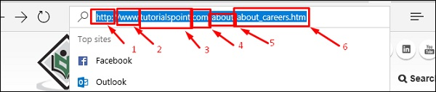
Each website has its own URL which is a unique global address called domain name. A URL comprises of −
The protocol used to access the website, which in this case is http, meaning port 80. It can also be https; port 443.
The subdomain which by default is www.
The domain name; domain names are normally chosen to have a meaning. Like in our case “tutorialspoint”, we can understand that this website offers tutorials.
The suffix name which can be .com, .info, .net, .biz, or country specific. The directories or in simple words, a folder in the server that holds this website.
The webpage that we are looking at, in our example, it is “about_careers.htm”.

Slide 8
Why Do We Need Websites?
Websites primarily act as a bridge between one who wants to share information and those who want to consume it.
Eg: If you are running a business, then it is almost imperative for you to have a website to broadcast your offerings and reach out to potential clients at a global stage.

Slide 9
Why it is important to have a website −
A website is an online brochure where you can advertise your business offers.
It gives you a platform to reach out to a far-and-wide global customer base.
If you are a blogger, you have the possibility to influence your readers.
You can show all your ideas and publish them on a website.
If you have a business idea, You can straightaway open an online shop and sell your products or services online. An added advantage is that the online shop will be open 24 x 7 for your clients, throughout the year.
You can communicate with your customers, giving them an opportunity to express themselves.
You can provide valuable customer support by having a trouble-ticket system.

Slide 10
How to Setup a Website?
A website is composed of several elements and while setting up a website, you would have to take care of each of them.
To set up a website and make it live, you should first purchase a hosting plan.
Select a domain name for this website.
Point the DNS records to the server or the hosting provider.
Develop the content that you want to publish on the website.
Check if you need to purchase a public certificate and install it.
Publish the webpage on the Internet.

Slide 11
If you are going to set up a professional website for a global audience, then you should have the following set of skills or you would have to hire a group of people to do this job for you.
Content Experts
Content experts supply the content that is to be published on the website. They design the content as per the requirement of the target audience and then, edit and polish the content before it gets published.
Content experts normally rely on the expertise of the site designer and the webmaster. Note that the content can be text, data, images, audio or links.
Website Designer
A web designer is a technical person who designs and maintains the Graphical User Interface (GUI) of the website. For example, where the buttons should be placed, how the images are to be displayed, etc.

Slide 12
Graphic Designers
Graphic designers develop image files that are to be included in the website. These professionals have a keen understanding of developing suitable graphics for the web environment.
Web Developers
Web developers create the program codes to manipulate the supplied content, based on the site design established by the website designer. A web programmer should use a set of programing languages to compile specific functions that the webpages should do in the background.

Slide 13
Important programing languages that a web programmer must be good at −
HTML / XHTML − These are the markup languages which you will use to build your website. A web programmer must have a good understanding of HTML and XML.
PHP − It is a popular programming language to develop webpages.
PERL Script − PERL is another language which is being used to develop interactive Web Applications
Java or VB Scripts − These scripts are required to perform user-level validations and to add more interactivity to your Website. So, a web developer is required to have adequate knowledge of any of these client-side scripts.
AJAX Technology − AJAX is the latest technology on the Web. Google and Yahoo are using this technology to give a better browsing experience to their website visitors.
ASP or JSP − Web developers are required to be well-versed with ASP or JSP to develop interactive websites.
Macromedia Flash − You can use Macromedia Flash to build a Website. It can be a little time-consuming to learn this technology, but once you learn how to use it, then you can develop attractive websites using Flash.

Slide 14
Web Researcher
You should research on new tools, trends and issues affecting the web technology. Web researchers report to the webmaster regarding new techniques that can be integrated in the website. They optimize appropriate site traffic and evaluate site development tools, which can be either hardware or software.
Hardware and Software Support Resource
The Support Resource upgrades the hardware and software as and when needed. They play a crucial role in keeping the system up and running in a flawless manner.

Slide 15
Marketing and Promotion
Marketing professionals mostly use popular Social Media Platforms such as Facebook and Twitter to promote the content and resources available on the site.
They reach out to the target audience and create awareness among them.
System Administrator
A System Administrator knows how to set up and point the protocols as HTTP, FTP, SMTP and DNS records.
System administrators are those experts who look after every aspect of website development and its maintenance.

Slide 16
Domain names
Domain name is the part of your online address and your visitors will use it to find you easily.
Your domain name is unique to you. Once you have registered it, nobody else can register the same one if you continue to renew it.

Slide 17
Domain Name Extensions [TLD- Top Level Domain]
.com – commercial − This is an open TLD; any person or entity is permitted to register and it is always the main TLD.
.org – organization − This is an open TLD; any person or entity is permitted to register. But, it is originally intended for use by any non-profit organizations. But as of now, there are no such restrictions and the .org domain name is being used by numerous organizations.
.net – network − This is an open TLD; any person or entity is permitted to register. It was originally intended for use by domains pointing to a distributed network of computers, or "Umbrella" sites that act as a portal to a set of smaller websites.
.edu – education − This TLD is limited to specific higher educational institutions such as, but not limited to, trade schools and universities.
.mil – military − The .mil TLD is limited to use by the United States military.
.arpa – Address and routing − It is for Advanced Research Projects Agency in the early days on the Internet, .arpa is now exclusively used as an Internet infrastructure TLD.

Slide 18
To register a domain name involves registering the name you want with an organization called ICANN through a domain name registrar. For example, if you choose a name like "mydomain.com", you should go to a registrar, pay a registration fee that costs around 10 USD per year for that name. That will give you the right to the domain name for a year. You should renew it annually for the same amount per annum.
ICANN=Internet Corporation for Assigned Names and Numbers

Slide 19
Some of the biggest registrars where you can register your domain are given below −
GoDaddy - with the URL https://uk.godaddy.com
Name – with the URL https://www.name.com/
iPage – with URL https://www.ipage.com
BlueHost – with URL https://www.bluehost.com/
Hostgator – with URL https://www.hostgator.com/

Slide 20
CMS Platform
Content Management System (CMS) Platforms are applications which allow to create and run your website. You will get an Admin Panel, which is an interface where you can create and update pages, posts and other type of content (images, videos, etc.) and arrange the content the way you need. The most prominent CMS platforms are WordPress, Joomla and Drupal.

Slide 21
E-Commerce Payment Gateway
Payment Gateway is an online payment processing technology which helps businesses to accept credit cards and electronic checks.
In other words, payment gateways are “Man-in-the-middle” which are located between e-commerce platforms and clients.

Slide 22
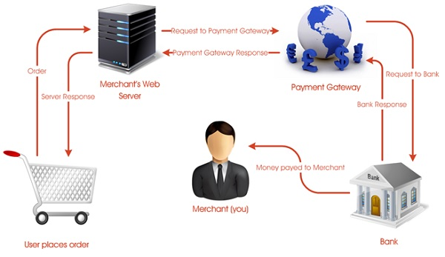
Payment Gateway

Slide 23
A payment gateway allows you to −
Make and take payments quickly and easily.
Keep your customer's data (information) and money secure.
Gain trust of your customers, so they are willing to hand over their money.
Most Popular Payment Gateway Providers
PAYPAL
AMAZON PAY
STRIPE
AUTHORIZE NET

Slide 24
WWW
WWW stands for World Wide Web. A technical definition of the World Wide Web is : all the resources and users on the Internet that are using the Hypertext Transfer Protocol (HTTP).
A broader definition comes from the organization that Web inventor Tim Berners-Lee helped found, the World Wide Web Consortium (W3C).
Internet and Web is not the same thing: Web uses internet to pass over the information.

Slide 25
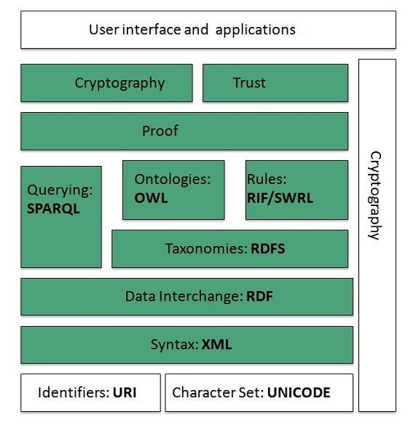
WWW Architecture

Slide 26
Identifiers and Character Set
Uniform Resource Identifier (URI) is used to uniquely identify resources on the web and UNICODE makes it possible to built web pages that can be read and write in human languages.
Syntax
XML (Extensible Markup Language) helps to define common syntax in semantic web.
Data Interchange
Resource Description Framework (RDF) framework helps in defining core representation of data for web. RDF represents data about resource in graph form.

Slide 27
Taxonomies
RDF Schema (RDFS) allows more standardized description of taxonomies and other ontological constructs.
Ontologies
Web Ontology Language (OWL) offers more constructs over RDFS. It comes in following three versions:
OWL Lite for taxonomies and simple constraints.
OWL DL for full description logic support.
OWL for more syntactic freedom of RDF
Rules
RIF and SWRL offers rules beyond the constructs that are available from RDFs and OWL. Simple Protocol and RDF Query Language (SPARQL) is SQL like language used for querying RDF data and OWL Ontologies.

Slide 28
Proof
All semantic and rules that are executed at layers below Proof and their result will be used to prove deductions.
Cryptography
Cryptography means such as digital signature for verification of the origin of sources is used.
User Interface and Applications
On the top of layer User interface and Applications layer is built for user interaction.

Slide 29
WWW Operation
WWW works on client- server approach.
Following steps explains how the web works:
User enters the URL of the web page in the address bar of web browser.
Then browser requests the Domain Name Server for the IP address corresponding to URL.
After receiving IP address, browser sends the request for web page to the web server using HTTP protocol which specifies the way the browser and web server communicates.
Then web server receives request using HTTP protocol and checks its search for the requested web page. If found it returns it back to the web browser and close the HTTP connection.
Now the web browser receives the web page, It interprets it and display the contents of web page in web browser’s window.

Slide 30
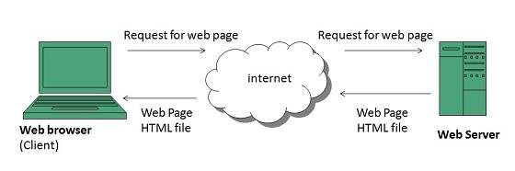
WWW Operation

Slide 31
Web Page
Web page is a document available on world wide web. Web Pages are stored on web server and can be viewed using a web browser.
A web page can contain huge information including text, graphics, audio, video and hyper links. These hyper links are the link to other web pages.
Collection of linked web pages on a web server is known as website. There is unique Uniform Resource Locator (URL) is associated with each web page

Slide 32
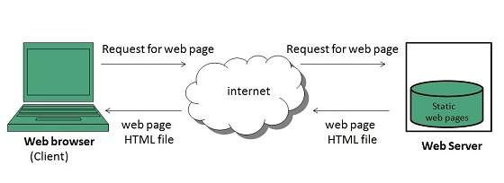
Static Web page
Static web pages are also known as flat or stationary web page. They are loaded on the client’s browser as exactly they are stored on the web server. Such web pages contain only static information. User can only read the information but can’t do any modification or interact with the information.
Static web pages are created using only HTML. Static web pages are only used when the information is no more required to be modified.

Slide 33
Dynamic Web page
Dynamic web page shows different information at different point of time. It is possible to change a portion of a web page without loading the entire web page. It has been made possible using AJAX technology.
Server-side dynamic web page
It is created by using server-side scripting. There are server-side scripting parameters that determine how to assemble a new web page which also include setting up of more client-side processing.
Client-side dynamic web page
It is processed using client side scripting such as JavaScript. And then passed in to Document Object Model (DOM).

Slide 34
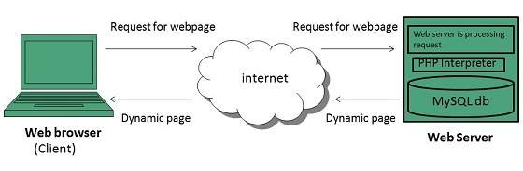
Dynamic Web page

Slide 35
Scripting Languages
Scripting languages are like programming languages that allow us to write programs in form of script. These scripts are interpreted not compiled and executed line by line.
Scripting language is used to create dynamic web pages.

Slide 36
Web Browser
Web Browser is an application software that allows us to view and explore information on the web. User can request for any web page by just entering a URL into address bar.
Web browser can show text, audio, video, animation and more. It is the responsibility of a web browser to interpret text and commands contained in the web page.
Earlier the web browsers were text-based while now a days graphical-based or voice-based web browsers are also available.

Slide 37
Popular web browser available today:
Browser | Vendor
Internet Explorer | Microsoft
Google Chrome | Google
Mozilla Firefox | Mozilla
Netscape Navigator | Netscape Communications Corp.
Opera | Opera Software
Safari | Apple
Sea Monkey | Mozilla Foundation
K-meleon | K-meleon

Slide 38
Web Server
Web Server is a computer where the web content is stored. Basically web server is used to host the web sites but there exists other web servers also such as gaming, storage, FTP, email etc.
Web site is collection of web pages while web server is a software that respond to the request for web resources.

Slide 39
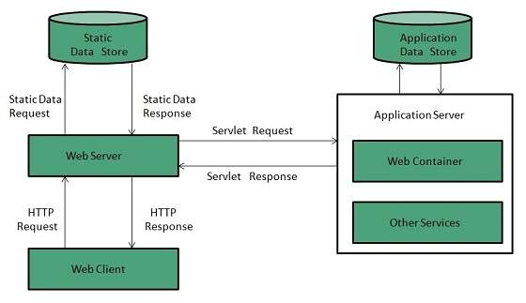
Web Server Working
Web server respond to the client request in either of the following two ways:
Sending the file to the client associated with the requested URL.
Generating response by invoking a script and communicating with database

Slide 40
Search engines
Search Engine refers to a huge database of internet resources such as web pages, newsgroups, programs, images etc. It helps to locate information on World Wide Web.
User can search for any information by passing query in form of keywords or phrase. It then searches for relevant information in its database and return to the user.

Slide 41
Popular Search Engines available today:
Search Engine | Description
Google | It was originally called BackRub. It is the most popular search engine globally.
Bing | It was launched in 2009 by Microsoft. It is the latest web-based search engine that also delivers Yahoo’s results.
Ask | It was launched in 1996 and was originally known as Ask Jeeves. It includes support for match, dictionary, and conversation question.
AltaVista | It was launched by Digital Equipment Corporation in 1995. Since 2003, it is powered by Yahoo technology.
AOL.Search | It is powered by Google.
LYCOS | It is top 5 internet portal and 13th largest online property according to Media Matrix.
Alexa | It is subsidiary of Amazon and used for providing website traffic information.

Slide 42
Web Development Overview
There are two broad divisions of web development – Front-End development (also called client-side development) and Back-End development (also called server-side development).
Front-end development refers to constructing what a user sees when they load a web application – the content, design and how you interact with it. This is done with three codes – HTML, CSS and JavaScript.

Slide 43
HTML, CSS, and JavaScript
HTML, short for Hyper Text Markup Language, is a special code for ‘marking up’ text in order to turn it into a web page. Every web page on the net is written in HTML, and it will form the backbone of any web application.
CSS, short for Cascading Style Sheets, is a code for setting style rules for the appearance of web pages. CSS handles the cosmetic side of the web.
JavaScript is a scripting language that’s widely used to add functionality and interactivity to web pages.

Slide 44
Back-end scripts are written in many different coding languages and frameworks, such as…
PHP
Ruby on Rails
ASP.NET
Perl
Java
Node.JS
Python

Slide 45
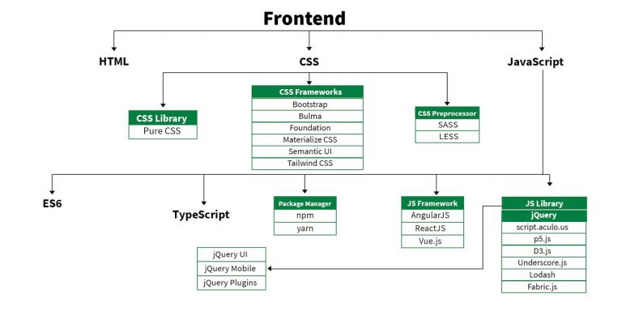
Frontend Roadmap
●●●
45
Notes:
SAY: Before we wrap up the course, let’s review what we have learned today.
During this course, we have
<READ the bullets from the slide.>
GO to next slide.

Slide 46
Frontend Roadmap
HTML: HTML stands for HyperText Markup Language. It is used to design the front end portion of web pages using markup language. It acts as a skeleton for a website since it is used to make the structure of a website.
CSS: Cascading Style Sheets fondly referred to as CSS is a simply designed language intended to simplify the process of making web pages presentable. It is used to style our website.
JavaScript: JavaScript is a scripting language used to provide a dynamic behavior to our website.
●●●
46
Notes:
SAY: Before we wrap up the course, let’s review what we have learned today.
During this course, we have
<READ the bullets from the slide.>
GO to next slide.

Slide 47
Frontend Roadmap
Bootstrap: Bootstrap is a free and open-source tool collection for creating responsive websites and web applications.
It is the most popular CSS framework for developing responsive, mobile-first websites. Nowadays, the websites are perfect for all the browsers (IE, Firefox, and Chrome) and for all sizes of screens (Desktop, Tablets, Phablets, and Phones).
Bootstrap 4
Bootstrap 5
●●●
47
Notes:
SAY: Before we wrap up the course, let’s review what we have learned today.
During this course, we have
<READ the bullets from the slide.>
GO to next slide.

Slide 48
Frontend Roadmap
Frontend Frameworks and Libraries:
AngularJS
React.js
VueJS
jQuery
Bootstrap
Material UI
Tailwind CSS
jQuery UI
48
Notes:
SAY: Before we wrap up the course, let’s review what we have learned today.
During this course, we have
<READ the bullets from the slide.>
GO to next slide.

Slide 49
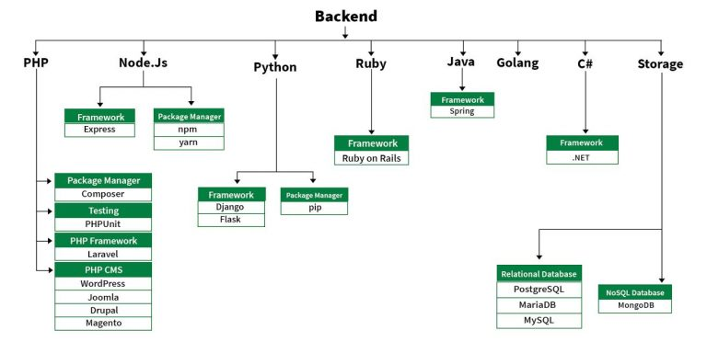
Backend Roadmap
●●●
49
Notes:
SAY:
The purpose of epidemiology in public health practice is to
discover the agent, host, and environmental factors that affect health;
determine the relative importance of causes of illness, disability, and death;
identify those segments of the population that have the greatest risk from specific causes of ill health; and
evaluate the effectiveness of health programs and services in improving population health.
GO to next slide.

Slide 50
Backend Roadmap
PHP: PHP is a server-side scripting language designed specifically for web development.
Java: Java is one of the most popular and widely used programming language. It is highly scalable.
Python: Python is a programming language that lets you work quickly and integrate systems more efficiently.
Node.js: Node.js is an open source and cross-platform runtime environment for executing JavaScript code outside a browser.
●●●
50
Notes:
SAY:
The purpose of epidemiology in public health practice is to
discover the agent, host, and environmental factors that affect health;
determine the relative importance of causes of illness, disability, and death;
identify those segments of the population that have the greatest risk from specific causes of ill health; and
evaluate the effectiveness of health programs and services in improving population health.
GO to next slide.

Slide 51
Backend Roadmap
Back End Frameworks
The list of back end frameworks are:
Express,
Django,
Rails,
Laravel,
Spring, etc.
51
Notes:
SAY:
The purpose of epidemiology in public health practice is to
discover the agent, host, and environmental factors that affect health;
determine the relative importance of causes of illness, disability, and death;
identify those segments of the population that have the greatest risk from specific causes of ill health; and
evaluate the effectiveness of health programs and services in improving population health.
GO to next slide.

Slide 52
Introduction to HTML and
CSS

